Slide 1
UNIT-2.4
JOINS

Slide 2
What is Join in DBMS?
Join in DBMS is a binary operation which allows you to combine join product and selection in one single statement. The goal of creating a join condition is that it helps you to combine the data from two or more DBMS tables. The tables in DBMS are associated using the primary key and foreign keys.
Types of Join
There are mainly two types of joins in DBMS:
Inner Joins: Theta, Natural, EQUI
Outer Join: Left, Right, Full
Inner Join
Theta Join
EQUI join:
Natural Join (⋈)
Outer Join
Left Outer Join (A B)
Right Outer Join (A B)
Full Outer Join (A B)

Slide 3
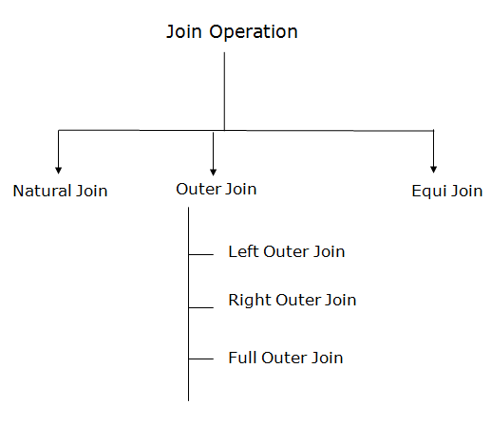
Types of Join operations:

Slide 4
Inner Join
INNER JOIN is used to return rows from both tables which satisfy the given condition. It is the most widely used join operation and can be considered as a default join-type
An Inner join or equijoin is a comparator-based join which uses equality comparisons in the join-predicate. However, if you use other comparison operators like “>” it can’t be called equijoin.
Inner Join further divided into three subtypes:
Theta join
Natural join
EQUI join
Theta Join
THETA JOIN allows you to merge two tables based on the condition represented by theta. Theta joins work for all comparison operators. It is denoted by symbol θ. The general case of JOIN operation is called a Theta join.
Syntax:
A ⋈_{θ} B

Slide 5
Notation
R1 ⋈_{θ} R2
R1 and R2 are relations having attributes (A1, A2, .., An) and (B1, B2,.. ,Bn) such that the attributes don’t have anything in common, that is R1 ∩ R2 = Φ.
Theta join can use all kinds of comparison operators.
Student
SID | Name | Std
101 | Alex | 10
102 | Maria | 11
Subjects
Class | Subject
10 | Math
10 | English
11 | Music
11 | Sports
Student_Detail −
STUDENT ⋈_{Student.Std = Subject.Class}SUBJECT

Slide 6
Student_detail
SID | Name | Std | Class | Subject
101 | Alex | 10 | 10 | Math
101 | Alex | 10 | 10 | English
102 | Maria | 11 | 11 | Music
102 | Maria | 11 | 11 | Sports
Equijoin
When Theta join uses only equality comparison operator, it is said to be equijoin. The above example corresponds to equijoin.
EQUI Join
EQUI JOIN is done when a Theta join uses only the equivalence condition. EQUI join is the most difficult operation to implement efficiently in an RDBMS, and one reason why RDBMS have essential performance problems.
For example:
A ⋈ _{A.column 2 = B.column 2} (B)
A ⋈ A.column 2 = B.column 2 (B)
Column 1 | column 2
1 | 1

Slide 7
Natural Join (⋈)
Natural join does not use any comparison operator. It does not concatenate the way a Cartesian product does. We can perform a Natural Join only if there is at least one common attribute that exists between two relations. In addition, the attributes must have the same name and domain.
Natural join acts on those matching attributes where the values of attributes in both the relations are same.
Select employee.empId, employee.empName, department.deptId, department.deptName from employee Natural Join department;
Example:
Consider the following two tables
C
Num | Square
2 | 4
3 | 9
D
Num | Cube
2 | 8
3 | 18
C ⋈ D

Slide 8
Outer Join
An OUTER JOIN doesn’t require each record in the two join tables to have a matching record. In this type of join, the table retains each record even if no other matching record exists.
Three types of Outer Joins are:
Left Outer Join
Right Outer Join
Full Outer Join
Left Outer Join (A B)
LEFT JOIN returns all the rows from the table on the left even if no matching rows have been found in the table on right. When no matching record found in the table on the right, NULL is returned.

Slide 9
Consider the following 2 Tables
A
Num | Square
2 | 4
3 | 9
4 | 16
B
Num | Cube
2 | 8
3 | 18
5 | 75
A B
Num | Square | Cube
2 | 4 | 8
3 | 9 | 18

Slide 10
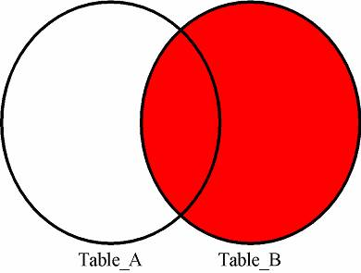
RIGHT JOIN: RIGHT JOIN is similar to LEFT JOIN. This join returns all the rows of the table on the right side of the join and matching rows for the table on the left side of join. The rows for which there is no matching row on left side, the result-set will contain null. RIGHT JOIN is also known as RIGHT OUTER JOIN.
Syntax:
SELECT table1.column1,table1.column2,table2.column1,.... FROM table1 RIGHT JOIN table2 ON table1.matching_column = table2.matching_column;
table1: First table.
table2: Second table matching_column:
Column common to both the tables.

Slide 11
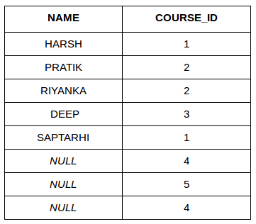
SELECT Student.NAME, StudentCourse.COURSE_ID FROM Student RIGHT JOIN StudentCourse ON StudentCourse.ROLL_NO = Student.ROLL_NO;
Output:
FULL JOIN: FULL JOIN creates the result-set by combining result of both LEFT JOIN and RIGHT JOIN. The result-set will contain all the rows from both the tables. The rows for which there is no matching, the result-set will contain NULL values

Slide 12
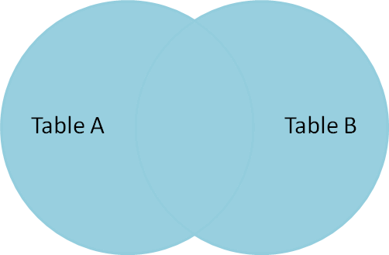
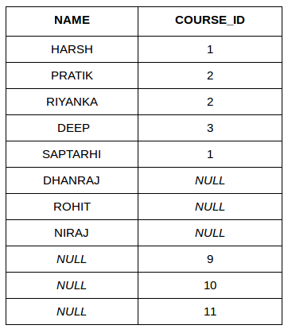
Syntax:
SELECT table1.column1,table1.column2,table2.column1,.... FROM table1 FULL JOIN table2 ON table1.matching_column = table2.matching_column;
table1: First table.
table2: Second table matching_column:
Column common to both the tables.
SELECT Student.NAME,StudentCourse.COURSE_ID FROM Student FULL JOIN StudentCourse ON StudentCourse.ROLL_NO = Student.ROLL_NO;

Slide 13
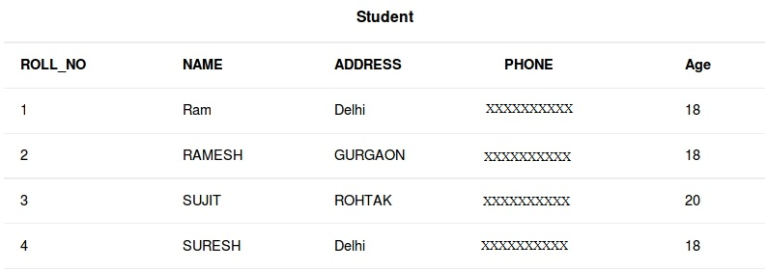
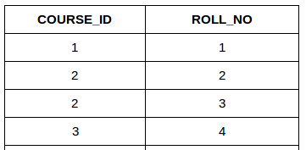
(Cartesian Join & Self Join)
Consider the two tables below:
StudentCourse

Slide 14
CARTESIAN JOIN: The CARTESIAN JOIN is also known as CROSS JOIN. In a CARTESIAN JOIN there is a join for each row of one table to every row of another table. This usually happens when the matching column or WHERE condition is not specified. In the absence of a WHERE condition the CARTESIAN JOIN will behave like a CARTESIAN PRODUCT . i.e., the number of rows in the result-set is the product of the number of rows of the two tables.
In the presence of WHERE condition this JOIN will function like a INNER JOIN.
Generally speaking, Cross join is similar to an inner join where the join-condition will always evaluate to True
SELECT table1.column1 , table1.column2, table2.column1... FROM table1 CROSS JOIN table2;
table1: First table.
table2: Second table
In the below query we will select NAME and Age from Student table and COURSE_ID from StudentCourse table. In the output you can see that each row of the table Student is joined with every row of the table StudentCourse. The total rows in the result-set = 4 * 4 = 16.

Slide 15
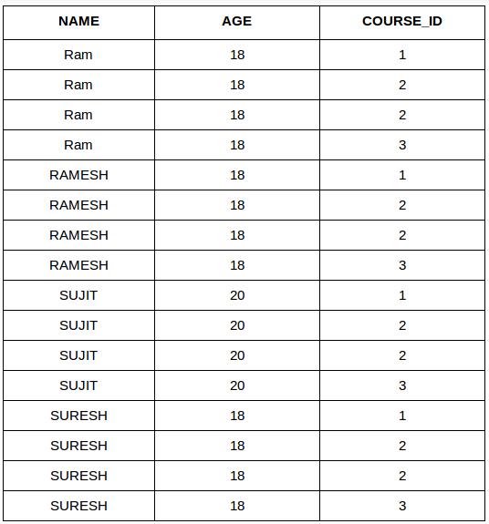
SELECT Student.NAME, Student.AGE, StudentCourse.COURSE_ID FROM Student CROSS JOIN StudentCourse;

Slide 16
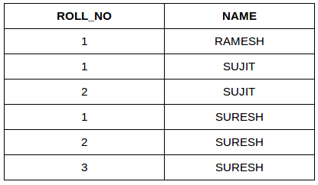
SELF JOIN: As the name signifies, in SELF JOIN a table is joined to itself. That is, each row of the table is joined with itself and all other rows depending on some conditions. In other words we can say that it is a join between two copies of the same table. Syntax:
SELECT a.coulmn1 , b.column2 FROM table_name a, table_name b WHERE some_condition; table_name:
Name of the table. some_condition:
Condition for selecting the rows.
SELECT a.ROLL_NO , b.NAME FROM Student a, Student b WHERE a.ROLL_NO < b.ROLL_NO;

